Slide 1

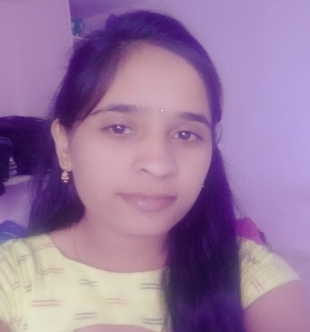






Metri Savitha
Education and certificates
Bachelor of Engineering
Electronics Engineering : 2015 - 2019
Skills
Sr Analyst/Software Engineer
Base Location: Hyderabad
Email ID:Savitha.metri@capgemini.com
Mobile No: +91 9573210378
Grade: A5
Java 8
/J2EE
Java Basics, OOPS, Generics, Collections, Arrays, Loops, Lambda Exp, Stream API.
Spring core
Spring REST
IOC & Dependency Injection, Autowire
REST controllers, Implementation of GET, POST, PUT & DELETE.
Bean Validation & Exception Handling.
Strengths
Full Stack Developer
Achievement
• Hands on experience in creating microservices with Spring boot, Spring Security, Spring Cloud API Gateway, Eureka server.
• Completed the BULT i-Transform training in java Full Stack Development with react.
• Case Study on online crop deal along with API Gateway, Postman, Eureka server and responsive UI with HTML5, CSS3, Bootstrap, react.
• Degreed: Successfully completed the degreed training on git and GitHub, MongoDB, core Java, Spring Core, Spring boot, Spring Security, Spring Cloud, Spring AOP, HTML , CSS, React.
• CERTIFIED AWS Cloud Practitioner.
Spring Data JPA
Implement DAO layer using spring Data repositories, Transaction Management
Components, Hooks, virtual Dom, Routing, Forms & Validation.
React
• Proficient in creating Single page Web
Application in React.
Database
MongoDB, SQL, No SQL Basics. Microsoft SQL Server, RDMS Basics.
HTML 5 & CSS 3,JavaScript, TypeScript
Reusable templates.
Git, Postman, Maven, IDE, visual Studio, Visual Studio Code.
AWS Cloud Practitioner.
• Hands on experience in Developing Web Application Using Java Spring Boot And Angular.
• Practical Understanding Of Core Java, Spring Framework, MongoDB, HTML5, CSS3, JAVASCRIPT, TYPESCRIPT, react, Git and GitHub.
UI Tech
Tools
Cloud
Add On skills
Agile Software Development.
Presentation Title | Author | Date © Capgemini 2017. All rights reserved | 1

